Slide 1
IP-Internet Protocol Addresses

Slide 2
Addresses for the Virtual Internet
The goal of internetworking is to provide a seamless communication system
Internet protocol software must hide the details of physical networks and offer facilities of a large network.
The virtual internet operates much like any network.
Internet allows computers to send and receive packets of information.

Slide 3
Internet and a physical network
An internet is an abstraction imagined by its designers and created by software.
The designers are free to choose addresses, packet format and delivery techniques.
All of them are independent of the details of the physical hardware.

Slide 4
Addressing
Addressing is a critical component of the internet abstraction.
All host computers must use a uniform addressing scheme
Each address must be unique.
To guarantee uniform addressing for all hosts, protocol software defines an addressing scheme.
The addressing scheme is an abstraction created by software.

Slide 5
Addressing (2)
Protocol addresses are used as destinations for the virtual internet analogous to the way hardware addresses used as destination on a physical network.
The sender places the destination’s protocol address in the packet, then passes the packet to protocol software for delivery.
The software uses the destination protocol address when it forwards the packet across the internet to the destination computer.

Slide 6
Benefits of uniform addressing
Uniform addressing helps to create the illusion of a large, seamless network.
It hides the details of the underlying physical network addresses.
Two application programs can communicate without knowing other hardware address.
Many layers of protocol software use protocol addresses.

Slide 7
Summary
To provide uniform addressing in an internet, protocol software defines an abstract addressing scheme that assigns each host a unique address.
Users, application programs and higher layers of protocol software use the abstract protocol addresses to communicate.

Slide 8
IP Addressing Scheme
Addressing is specified by the Internet Protocol.
Each host is assigned a unique 32 bit number.
This number is known as that host’s Internet Protocol Address.
It is commonly abbreviated as IP address or Internet address.
To transmit information on the internet, each packet should include IP address.
An internet address is an 32-bit binary number assigned to a host and used for all communication with the host.

Slide 9
IP Address Hierarchy
Each IP address has two parts:
  Prefix
  Suffix
Prefix identifies the physical network to which the computer is attached.
Suffix identifies an individual computer on the network.
Each physical network on the internet has its own network number.
Each network number is unique.
Suffixes may be same on different networks.

Slide 10
IP Address Hierarchy (2)
IP address hierarchy guarantees two important properties:
  Each computer is assigned a unique address.
  Although network number assignments must be coordinated globally, suffixes can be assigned locally without global coordination.
First property is guaranteed.

Slide 11
IP address classes
The designers of IP had to determine how many bits to place in each part.
The prefix need sufficient bits to allow a unique network number to be assigned to each physical network in an internet.
The suffix needs sufficient bits to permit each computer attached to the network to be assigned a unique suffix.

Slide 12
IP address classes (2)
Choosing a large prefix accommodates many networks, but limits the size of the network.
Choosing a large suffix accommodates many hosts on a networks, but limits the total number of networks.
A single internet can contain large and small networks.
The designers chose an addressing scheme that can accommodate a combination of large and small networks.

Slide 13
Classful IP addressing
This is the original scheme.
Known as Classful IP addressing.
It divides the IP address space into three primary classes.
Each class has a different size prefix and suffix.

Slide 14
Defining IP Address classes
The first four bits of an address
  determine the class to which the address belongs.
  specify how the reminder of the address is divided into prefix and suffix.

Slide 15
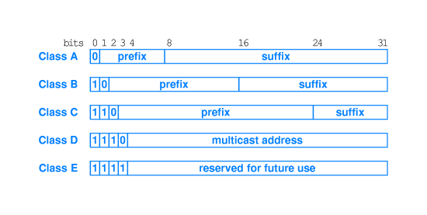
IP classes

Slide 16
IP classes (2)
Classes A, B, and C are primary classes.
They are used for host addresses.
Class D is used for multicasting
To use multicasting, a set of computers must agree to share a multicast address.
The class of an address determines the boundary between the network prefix and host suffix.

Slide 17
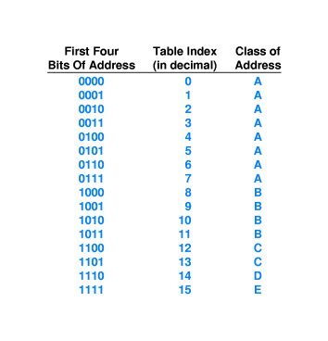
Computing the IP address class
Knowing the first 4 bits is enough to find the IP address class.
Classful IP addresses are self identifying, because the class of the address can be computed from the address itself.

Slide 18
Dotted Decimal Notation (DDN)
Binary notation is not easy to be understood.
IP addresses can be defined in decimal values.
It is called “Dotted Decimal Notation”
Dotted Decimal Notation is a syntactic form that IP software uses to express 32-bit binary values when interacting with humans.
Dotted decimal represents each octet in decimal and uses a dot to separate octets.
Dotted decimal addresses range from 0.0.0.0 to 255.255.255.255

Slide 19
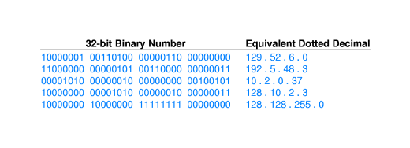
Dotted Decimal Notation (2)

Slide 20
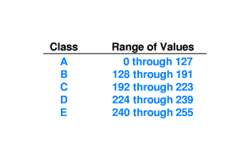
Classes and DDN
An IP address class must be recognized from the decimal value of the first octet.

Slide 21
Classes of IP Addresses
Class | From | To
A | 0.0.0.0 | 127.255.255.255
B | 128.0.0.0 | 191.255.255.255
C | 192.0.0.0 | 223.255.255.255
D | 224.0.0.0 | 239.255.255.255
E | 240.0.0.0 | 255.255.255.255

Slide 22
IPv4 Address Model
IP addresses
  Decimal-dot notation
  Host in class A network
    56.0.78.100 www.usps.gov
  Host in class B network
    128.174.252.1 www.cs.uiuc.edu
  Host in class C network
    198.182.196.56 www.linux.org

Slide 23
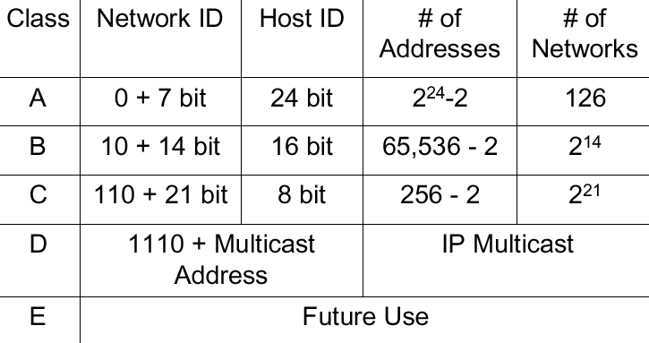
IPv4 Address Model

Slide 24
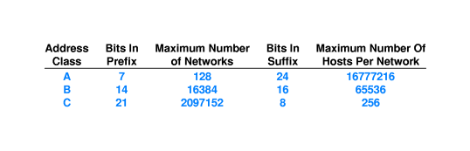
Division of the Address Space
Addresses can not be divided equally.
Internet Assigned Number Authority is the central coordinator organization.
IANA ensures that, each network prefix is unique throughout the internet.

Slide 25
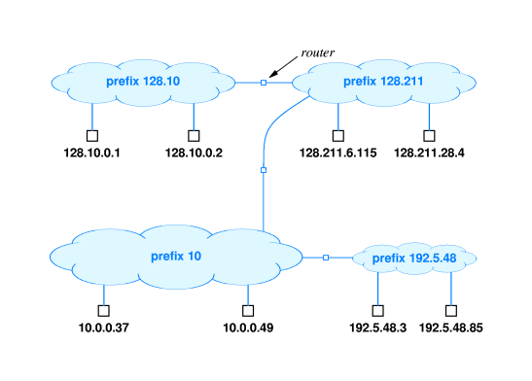
An example

Slide 26
Subnet and Classless Addressing
Since all networks had to choose one of three possible sizes, many addresses were unused.
Two new mechanisms were invented to overcome the limitations.
Subnet addressing
Classless addressing
These mechanisms allow the division between prefix and suffix to occur on an arbitrary bit boundary.

Slide 27
Advantages of Subnetting
Improves efficiency of IP addresses by not consuming an entire Class B or Class C address for each physical network
Reduces router complexity. Since external routers do not know about subnetting, the complexity of routing tables at external routers is reduced.
With subnetting, IP addresses use a 3-layer hierarchy:
  Network
  Subnet
  Host

Slide 28
Problems
Too few network addresses for large networks
  Class A and Class B addresses are gone
Two-layer hierarchy is not appropriate for large networks with Class A and Class B addresses.
  Subnetting
Inflexible.
Exploding Routing Tables: Routing on the backbone Internet needs to have an entry for each network address. In 1993, the size of the routing tables started to outgrow the capacity of routers.
The Internet is going to outgrow the 32-bit addresses
  IP Version 6

Slide 29
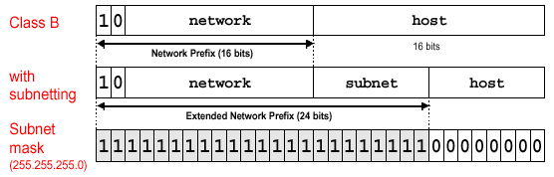
Subnetting
Part of the host number (suffix) can be used to identify a (sub) network
  IP address space has a 3-level hierarchy
  Hosts and routers need to know the subnetmask
Subnetting with mask 255.255.255.0 is quite common.

Slide 30
Address Masks
An additional information is required to specify the exact boundary between the network prefix andthe host suffix.
Tables inside hosts and routers must keep two pieces of information with each address:
  The 32 bit address
  The additional 32-bit value that specifies the boundary between the network prefix and suffix.
  This additional information is known as “Address Mask” or “Network Mask”.

Slide 31
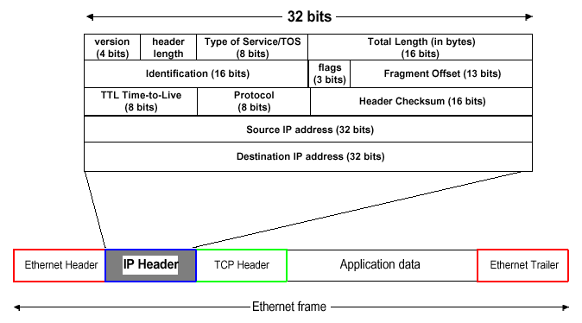
IPv4 Header

Slide 32
Finding the Network
A router is given a destination address (D), and a pair (Address, Mask)
A== (D & M) (Logical “and” operation)
The router uses the mask with a “logical and” operation to set the host bits of address D to zero, then compares the result with the network prefix A.

Slide 33
An example (Network Address)
32 bit mask:
  11111111 11111111 00000000 00000000
  255.255.0.0
Network prefix:
  10000000 00001010 00000000 00000000
  128.10.0.0
Destination address:
  128.10.2.3
  10000000 00001010 00000010 00000011
After the logical “and” the result is:
  10000000 00001010 00000000 00000000
  128.10.0.0

Slide 34
CIDR Notation
Classless Inter-Domain Routing
Modified form of dotted decimal notation
Network 128.10.0.0
Network mask 255.255.0.0
In CIDR Notation
  128.10.0.0/16 == 128.10.0.0 255.255.0.0

Slide 35
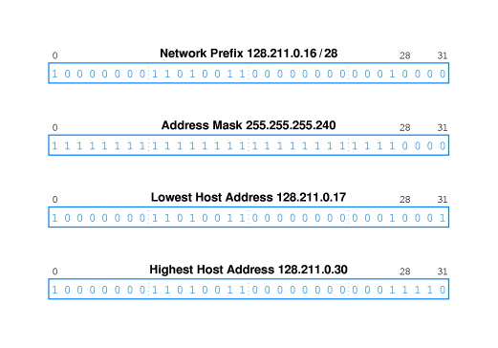
CIDR Host Addresses

Slide 36
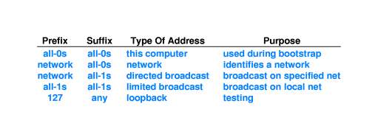
Special IP Addresses
Network Address
Directed Broadcast Address
Limited Broadcast Address
This Computer Address
Loopback Address

Slide 37
Reserved IP Addresses
Some IP address classes are reserved for internal use.
These addresses are not/can not be used on real internet.
These addresses must be changed to “real” IP addresses while connecting to the internet.
Network Address Translation (NAT) should be carried out.
A Class: 10.0.0.0 – 10.255.255.255
B Class: 172.16.0.0 – 172.31.255.255
C Class: 192.168.0.0 – 192.168.255.255

Slide 38
Routers and IP Addressing Principle
Each router is assigned two or more IP addresses.
A router has connections to multiple physical networks.
Each IP address contains a prefix that specifies a physical network.
An IP address does not identify a specific computer. Each IP address identifies a connection between a computer and a network.
A computer with multiple network connections (e.g. a router) must be assigned one IP address for each connection

Slide 39
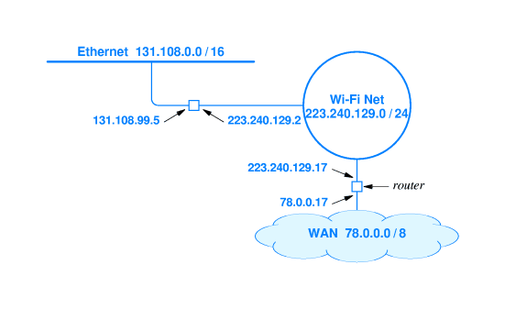
Router example

